Slide 1
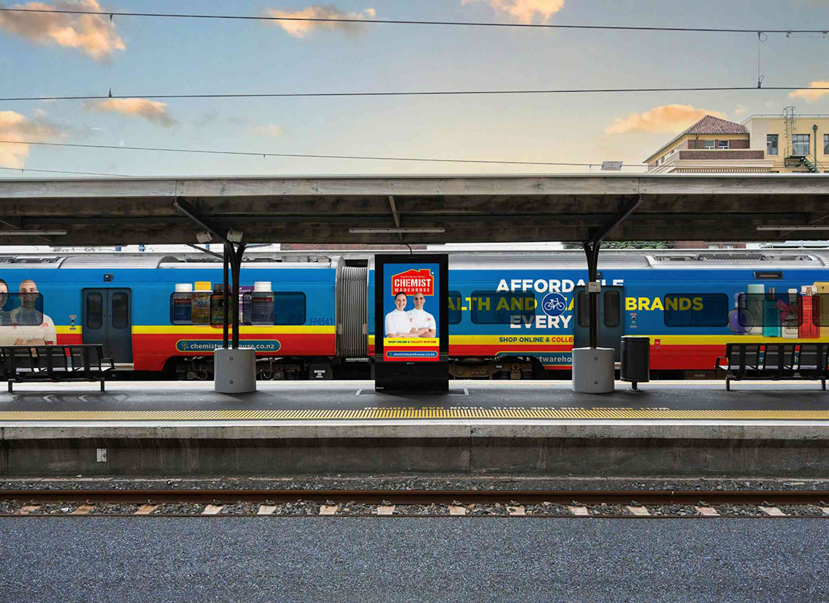
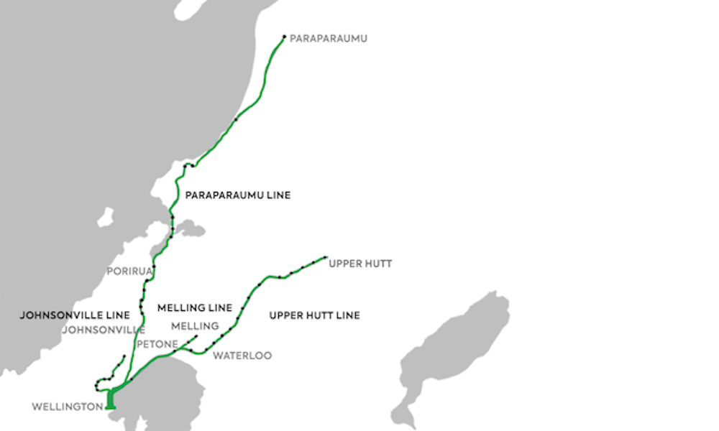
Wellington
TRAIN
Wellington Metro Rail Network
Ad Format:
Wrap
Elevate your brand awareness with our exclusive 40m train-wrap - an unmatched billboard in motion. Seen by train commuters, private vehicle users, and pedestrians in proximity to the 160km of rail network that traverses the region. For added impact 10km of the network travels alongside ad-free, multi-laned and congested SH1 and SH2. Beyond outdoor ads, train-wraps spark conversations and leave a lasting impression. Unleash the influential power of unparalleled visibility and make your brand unforgettable in the dynamic landscape of Greater Wellington.

