Slide 1
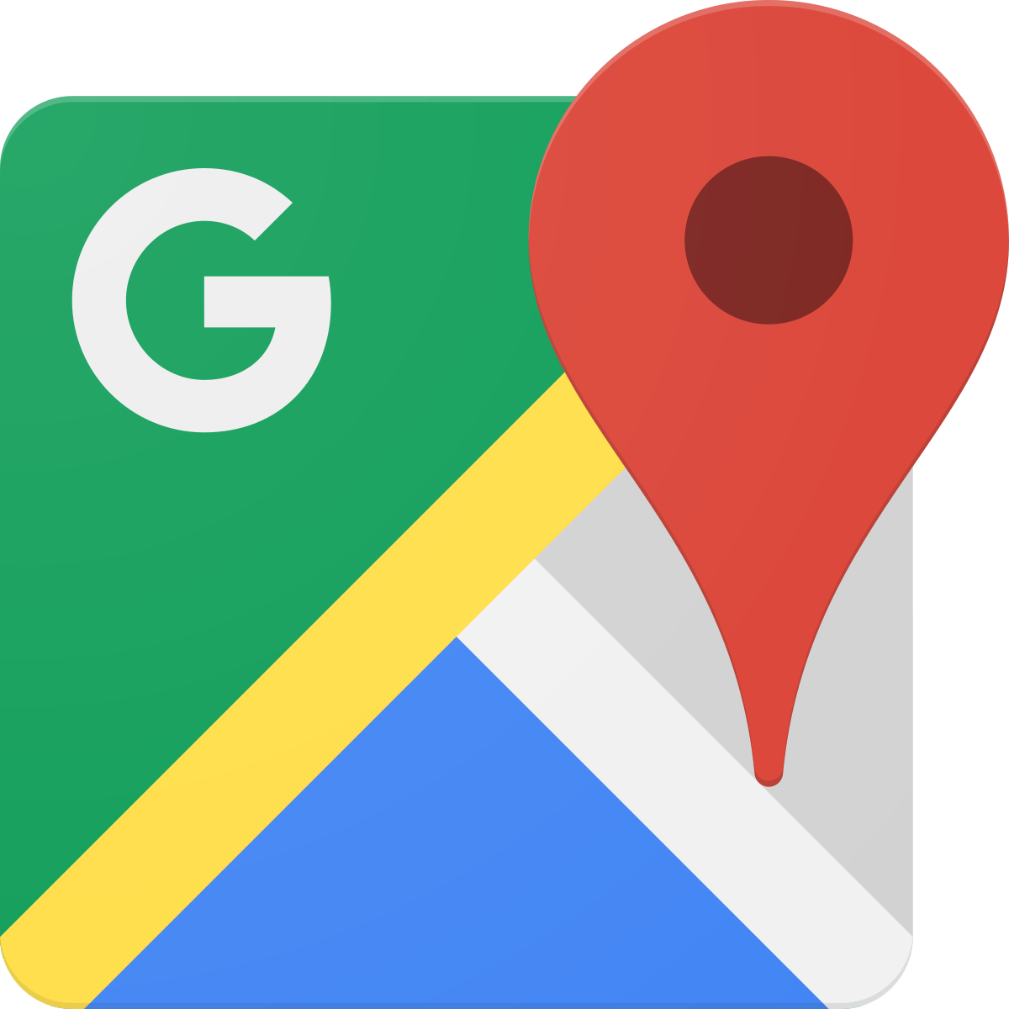
Wellington
DIGITAL ROADSIDE
Hutt Rd - Kaiwharawhara (OUT)
PANEL ID: WELLLED16
Orientation: Physical Size: Daily Visuals: Animation:
220° 6 x 3m 40,014 No
Ad Duration: Ads in Loop: Pixel Size: Operating Hours:
30 seconds 6 1200 x 600 0500-2459
This top reach performing digital screen located north of Wellington CBD on arterial Hutt Rd reaches outbound audiences heading to Ngauranga Gorge, Hutt Valley and Kāpiti Coast. Congestion at the traffic light-controlled intersection with Kaiwharawhara Rd assures high dwell times. Continental Cars BMW is in the vicinity. This location is a standout for audiences that visit Travel Agents, Office Supplies, QSR, DIY Hardware Stores and more (LANDMARKS ID).
Find on Google Maps
Find on Google Maps

