Slide 1
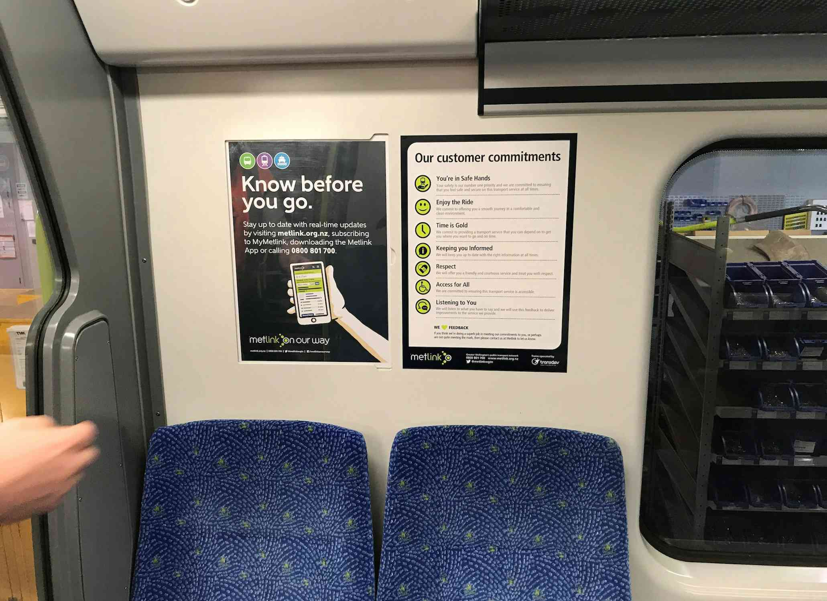
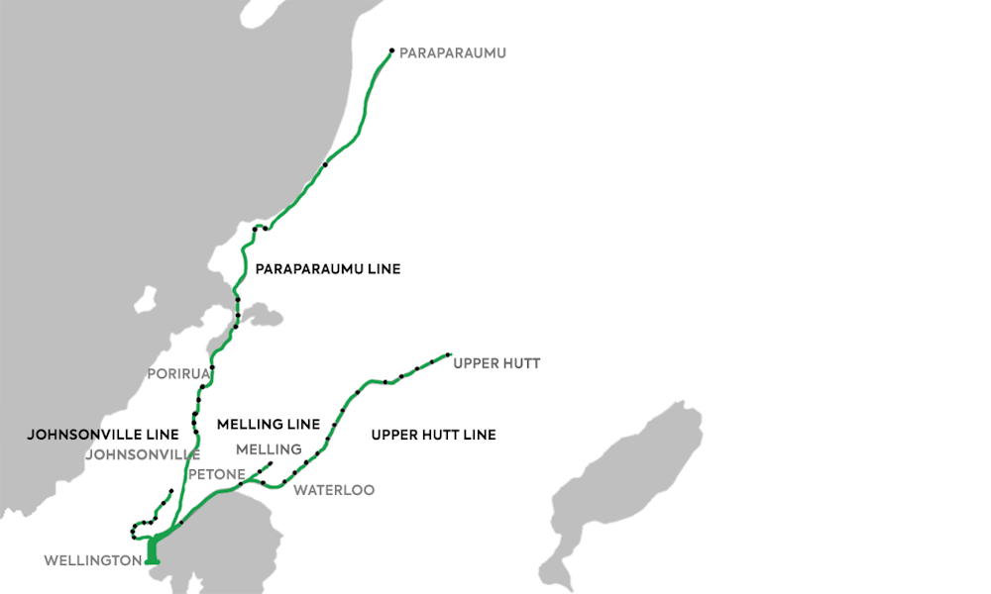
Wellington
TRAIN
Wellington Metro Rail Network
Ad Format:
A3 Posters
A3 posters placed in all 83 trains running the Paraparaumu, Upper Hutt, Melling and Johnsonville line will reach 1.205M commuter trips over a 4 week period. Coupled with high reach performance, trains offer a high dwell environment ranging from 9-60 minutes. The main audience composition of a Wellington train commuter includes; 54% are female, 70% are 25-59 year olds, 78% use the train to get to work and 63% travel every weekday.

